Slide 1
Predicting car accident severity

Slide 2
Predicting car accident severity is important for traffic departments to reduce accidents
Car Accidents in traffic lead to associated fatalities and economic losses every year worldwide and thus is an area of primary concern to society from loss prevention point of view.
In accident severity modeling, the input vectors are the characteristics of the accident, such as driver behaviour and attributes of vehicle, highway and environment characteristics while the output vector is the corresponding class of accident severity

Slide 3
Data acquisition and cleaning
The dataset in the SDOT(Seattle traffic department) dataset has 194673 rows of data and contains 38 columns including the severity(target) column.
The target variable severity code has either 1 or 2 analysed by using .unique attribute after loading the dataset into a dataframe.
the variables are analysed and checked whether to include in the analysis or not. Some of the columns are dropped from the analysis.
Finally the data is prepared for some classification algorithms to be tested
Cleaned data contains 55 columns of data.

Slide 4
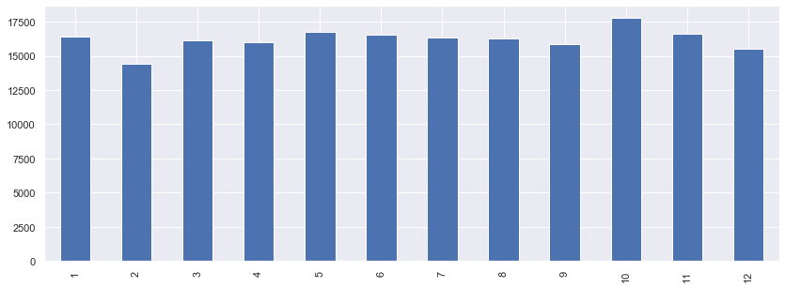
Distribution of accident report by month
Frequency of accident →
Month axis →

Slide 5
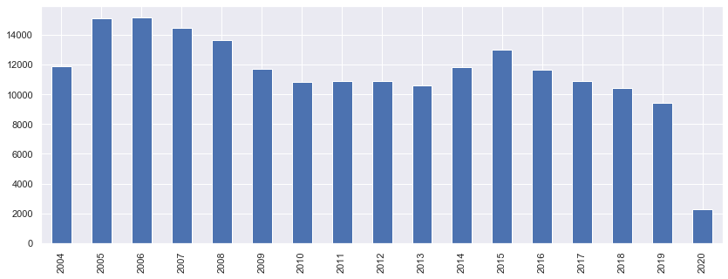
Distribution of accident report by year
Frequency of accident →
Year axis →

Slide 6
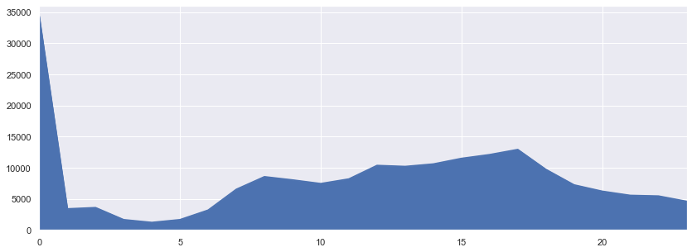
Distribution of accident report by hour of the day
Frequency of accident →
Time of the day →

Slide 7
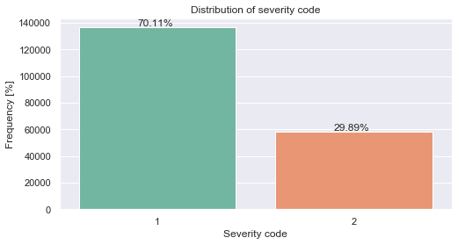
Distribution of target variable

Slide 8
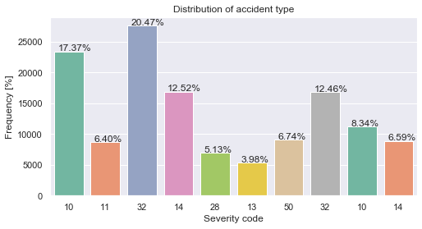
Distribution of most frequent severity code types

Slide 9
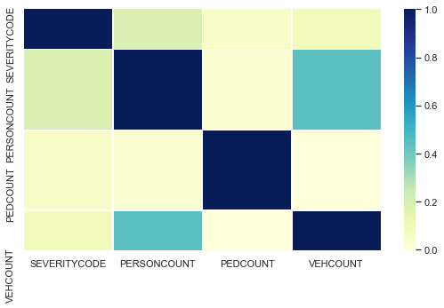
Correlation matrix

Slide 10
Conclusion and future path:
Visualizations give a certain understanding of variables in the columns of the dataset.
The output of the classification models like logistic regression, decision trees and random forest give almost perfect prediction with precision and recall of 1.
Many features like vehicle count and person count are heavily correlated which in turn represent the severity of the accident.
Future exploration of dataset further in absence of some of the columns would reveal the actual reality of prediction.
In future only the parameter that can be predetermined prior to the accident like road conditions, effect of weather and lighting conditions need to be explored for better results.

